Slide 1
Transactions
Properties
Schedules

Slide 2
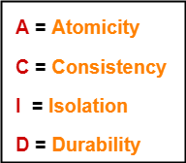
Desirable Properties of Transactions
It is important to ensure that the database remains consistent before and after the transaction.
To ensure the consistency of database, certain properties are followed by all the transactions occurring in the system.
These properties are called as ACID Properties of a transaction.

Slide 3
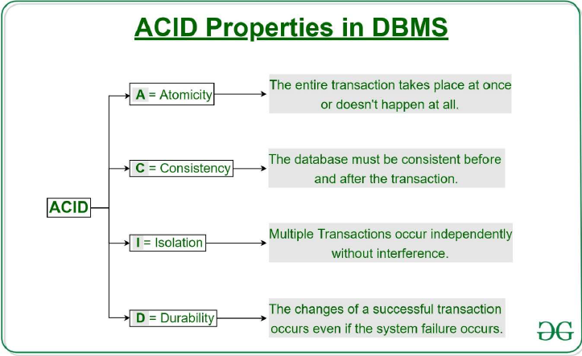

Slide 4
Atomicity:
Atomicity: The term atomicity defines that the data remains atomic. It means if any operation is performed on the data, either it should be performed or executed completely or should not be executed at all. It further means that the operation should not break in between or execute partially. In the case of executing operations on the transaction, the operation should be completely executed and not partially.
Consistency:
The word consistency means that the value should remain preserved always. In DBMS, the integrity of the data should be maintained, which means if a change in the database is made, it should remain preserved always. In the case of transactions, the integrity of the data is very essential so that the database remains consistent before and after the transaction. The data should always be correct.

Slide 5
Isolation:
The term 'isolation' means separation. In DBMS, Isolation is the property of a database where no data should affect the other one and may occur concurrently. In short, the operation on one database should begin when the operation on the first database gets complete. It means if two operations are being performed on two different databases, they may not affect the value of one another. In the case of transactions, when two or more transactions occur simultaneously, the consistency should remain maintained. Any changes that occur in any particular transaction will not be seen by other transactions until the change is not committed in the memory.
Durability:
Durability ensures the permanency of something. In DBMS, the term durability ensures that the data after the successful execution of the operation becomes permanent in the database. The durability of the data should be so perfect that even if the system fails or leads to a crash, the database still survives. However, if gets lost, it becomes the responsibility of the recovery manager for ensuring the durability of the database. For committing the values, the COMMIT command must be used every time we make changes.

Slide 6
Schedules of Transactions
Transaction schedule (or history): When transactions are executing concurrently in an interleaved fashion, the order of execution of operations from the various transactions forms what is known as a transaction schedule (or history).
Figure 21.5 (next slide) shows 4 possible schedules (A, B, C, D) of two transactions T1 and T2:
Order of operations from top to bottom
Each schedule includes same operations
Different order of operations in each schedule

Slide 7
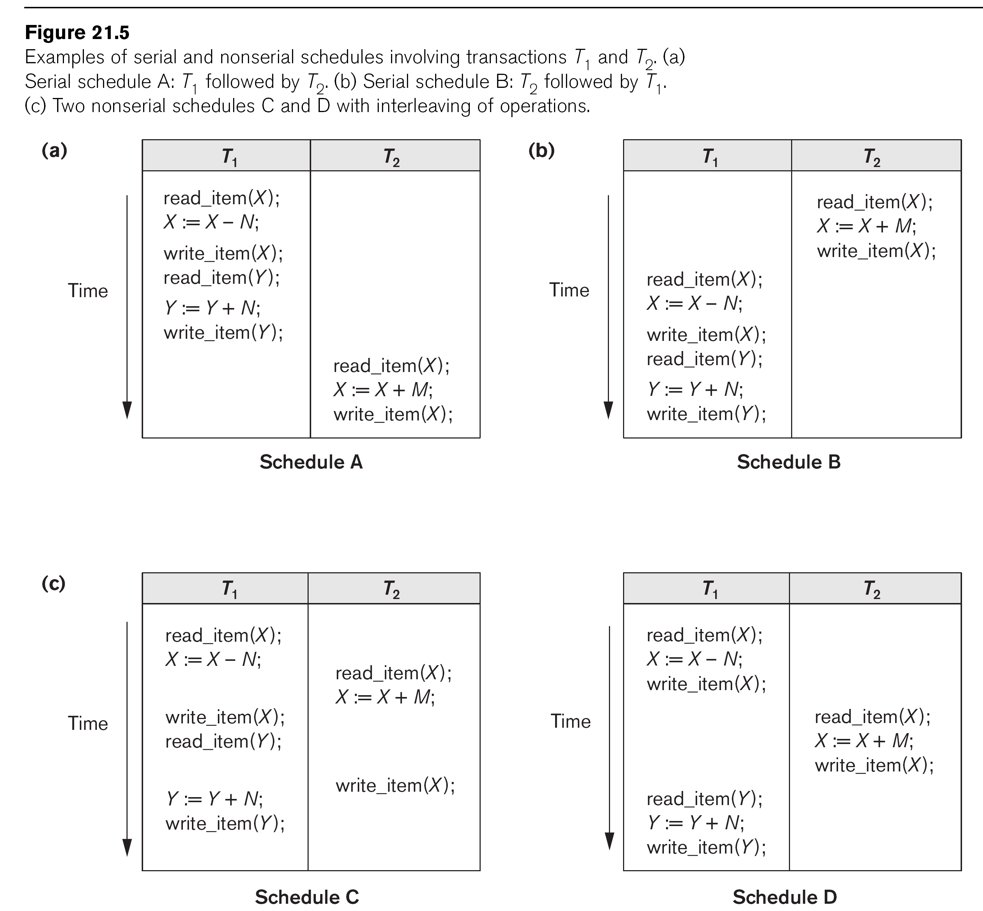

Slide 8
Schedules of Transactions (cont.)
Schedules can also be displayed in more compact notation
Order of operations from left to right
Include only read (r) and write (w) operations, with transaction id (1, 2, …) and item name (X, Y, …)
Can also include other operations such as b (begin), e (end), c (commit), a (abort)
Schedules in Figure 21.5 would be displayed as follows:
Schedule A: r1(X); w1(X); r1(Y); w1(Y); r2(X); w2(x);
Schedule B: r2(X); w2(X); r1(X); w1(X); r1(Y); w1(Y);
Schedule C: r1(X); r2(X); w1(X); r1(Y); w2(X); w1(Y);
Schedule D: r1(X); w1(X); r2(X); w2(X); r1(Y); w1(Y);

Slide 9
Schedules of Transactions (cont.)
Formal definition of a schedule (or history) S of n transactions T1, T2, ..., Tn :
An ordering of all the operations of the transactions subject to the constraint that, for each transaction Ti that participates in S, the operations of Ti in S must appear in the same order in which they occur in Ti.
Note: Operations from other transactions Tj can be interleaved with the operations of Ti in S.

Slide 10
Schedules of Transactions (cont.)
For n transactions T1, T2, ..., Tn, where each Ti has mi read and write operations, the number of possible schedules is (! is factorial function):
(m1 + m2 + … + mn)! / ( (m1)! * (m2)! * … * (mn)! )
Generally very large number of possible schedules
Some schedules are easy to recover from after a failure, while others are not
Some schedules produce correct results, while others produce incorrect results
Rest of chapter characterizes schedules by classifying them based on ease of recovery (recoverability) and correctness (serializability)

Slide 11
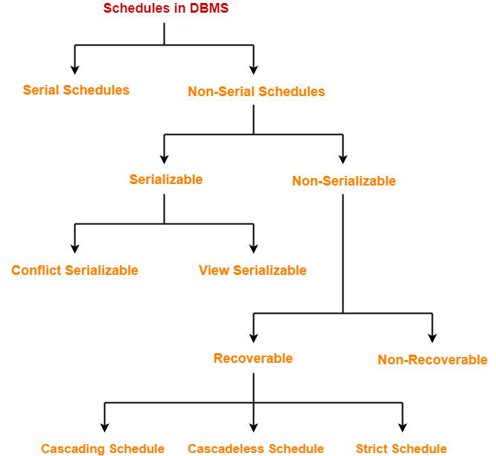
Types of Schedules-

Slide 12
Serial Schedules-
In serial schedules,
All the transactions execute serially one after the other.
When one transaction executes, no other transaction is allowed to execute.
Characteristics-
Serial schedules are always-
Consistent
Recoverable
Cascadeless
Strict

Slide 13
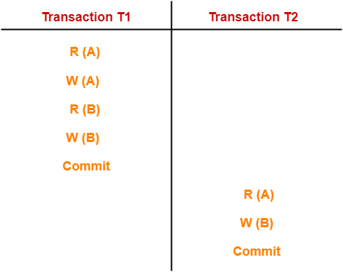
Serial Schedules- Example-01:
In this schedule,
There are two transactions T1 and T2 executing serially one after the other.
Transaction T1 executes first.
After T1 completes its execution, transaction T2 executes.
So, this schedule is an example of a Serial Schedule.

Slide 14
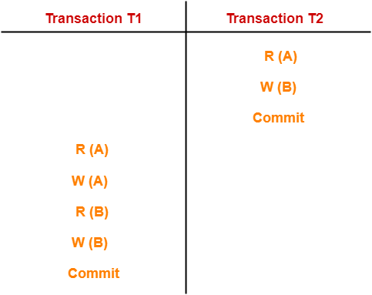
Serial Schedules- Example-02:
In this schedule,
There are two transactions T1 and T2 executing serially one after the other.
Transaction T2 executes first.
After T2 completes its execution, transaction T1 executes.
So, this schedule is an example of a Serial Schedule.

Slide 15
Non-Serial Schedules-
In non-serial schedules,
Multiple transactions execute concurrently.
Operations of all the transactions are inter leaved or mixed with each other.
Characteristics-
Non-serial schedules are NOT always-
Consistent
Recoverable
Cascadeless
Strict

Slide 16
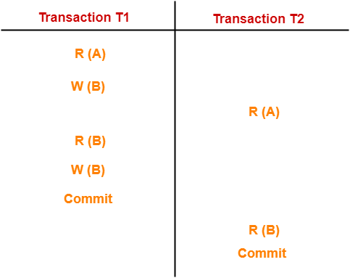
Non-Serial Schedules- Example-01:
In this schedule,
There are two transactions T1 and T2 executing concurrently.
The operations of T1 and T2 are interleaved.
So, this schedule is an example of a Non-Serial Schedule.

Slide 17
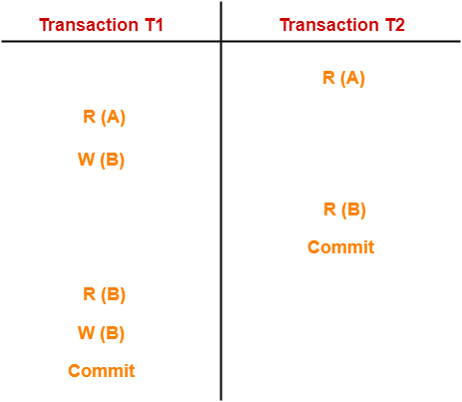
Non-Serial Schedules- Example-02:
In this schedule,
There are two transactions T1 and T2 executing concurrently.
The operations of T1 and T2 are interleaved.
So, this schedule is an example of a Non-Serial Schedule.

Slide 18

Finding Number Of Schedules-
Consider there are n number of transactions T1, T2, T3 …. , Tn with N1, N2, N3 …. , Nn number of operations respectively.
Total Number of Schedules-
Total number of possible schedules (serial + non-serial) is given by-

Slide 19
Total Number of Serial Schedules-
Total number of serial schedules
= Number of different ways of arranging n transactions
= n!

Slide 20
Total Number of Non-Serial Schedules-
Total number of non-serial schedules
= Total number of schedules – Total number of serial schedules

Slide 21
PRACTICE PROBLEM BASED ON FINDING NUMBER OF SCHEDULES-
Consider there are three transactions with 2, 3, 4 operations respectively, find-
How many total number of schedules are possible?
How many total number of serial schedules are possible?
How many total number of non-serial schedules are possible?

Slide 22
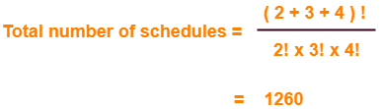
1. Solution-
1. Total Number of Schedules-

Slide 23
2. Solution-
Total Number of Serial Schedules-
Total number of serial schedules
= Number of different ways of arranging 3 transactions
= 3!
= 6

Slide 24
3. Solution-
Total Number of Non-Serial Schedules-
Total number of non-serial schedules
= Total number of schedules – Total number of serial schedules
= 1260 – 6
= 1254

Slide 25
A. Serializability in DBMS-
Some non-serial schedules may lead to inconsistency of the database.
Serializability is a concept that helps to identify which non-serial schedules are correct and will maintain the consistency of the database.

Slide 26
Serializable Schedules-
If a given non-serial schedule of ‘n’ transactions is equivalent to some serial schedule of ‘n’ transactions, then it is called as a serializable schedule.
Characteristics-
Serializable schedules behave exactly same as serial schedules.
Thus, serializable schedules are always-
Consistent
Recoverable
Casacadeless
Strict

Slide 27
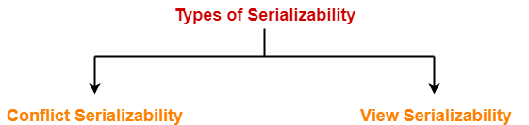
Types of Serializability-
Serializability is mainly of two types-

Slide 28
I. Conflict Serializability-
If a given non-serial schedule can be converted into a serial schedule by swapping its non-conflicting operations, then it is called as a conflict serializable schedule.
Conflicting Operations-
Two operations are called as conflicting operations if all the following conditions hold true for them-
Both the operations belong to different transactions
Both the operations are on the same data item
At least one of the two operations is a write operation

Slide 29
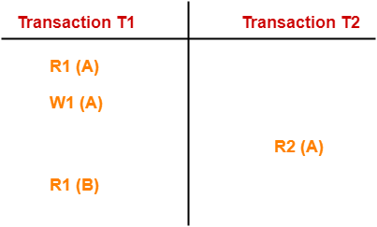
Example-
In this schedule,
W1 (A) and R2 (A) are called as conflicting operations.
This is because all the above conditions hold true for them.

Slide 30
Checking Whether a Schedule is Conflict Serializable Or Not-
Follow the following steps to check whether a given non-serial schedule is conflict serializable or not-
Step-01:
Find and list all the conflicting operations.
Step-02:
Start creating a precedence graph by drawing one node for each transaction.
Step-03:
Draw an edge for each conflict pair such that if X_{i} (V) and Y_{j} (V) forms a conflict pair then draw an edge from T_{i} to T_{j}.
This ensures that T_{i} gets executed before T_{j}.

Slide 31
Cont… Checking Whether a Schedule is Conflict Serializable Or Not-
Step-04:
Check if there is any cycle formed in the graph.
If there is no cycle found, then the schedule is conflict serializable otherwise not.

Slide 32
PRACTICE PROBLEMS BASED ON CONFLICT SERIALIZABILITY-
Problem-01:
Check whether the given schedule S is conflict serializable or not-
S : R₁(A) , R₂(A) , R₁(B) , R₂(B) , R₃(B) , W₁(A) , W₂(B)
Solution-
Step-01:
List all the conflicting operations and determine the dependency between the transactions-
R₂(A) , W₁(A) (T₂ → T₁)
R₁(B) , W₂(B) (T₁ → T₂)
R₃(B) , W₂(B) (T₃ → T₂)

Slide 33
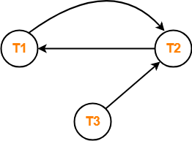
Problem-01: Cont…
Step-02:
Draw the precedence graph-
Clearly, there exists a cycle in the precedence graph.
Therefore, the given schedule S is not conflict serializable.

Slide 34
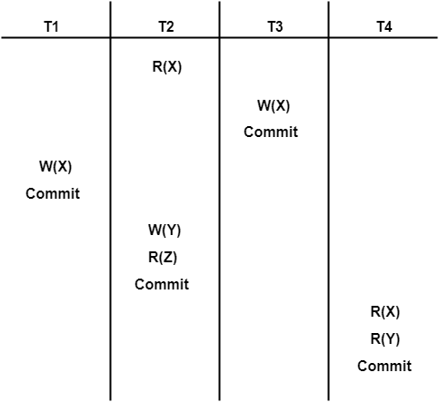
Problem-02:
Check whether the given schedule S is conflict serializable and recoverable or not-
Step-01:
List all the conflicting operations and determine the dependency between the transactions-
R₂(X) , W₃(X) (T₂ → T₃)
R₂(X) , W₁(X) (T₂ → T₁)
W₃(X) , W₁(X) (T₃ → T₁)
W₃(X) , R₄(X) (T₃ → T₄)
W₁(X) , R₄(X) (T₁ → T₄)
W₂(Y) , R₄(Y) (T₂ → T₄)

Slide 35
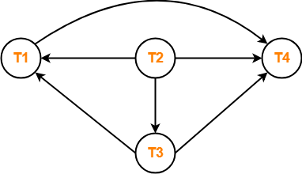
Cont… Problem-02:
Step-02:
Draw the precedence graph-
Clearly, there exists no cycle in the precedence graph.
Therefore, the given schedule S is conflict serializable.

Slide 36
Checking Whether S is Recoverable Or Not-
Conflict serializable schedules are always recoverable.
Therefore, the given schedule S is recoverable.

Slide 39
II. View Serializability-
If a given schedule is found to be view equivalent to some serial schedule, then it is called as a view serializable schedule.
View Equivalent Schedules-
Consider two schedules S1 and S2 each consisting of two transactions T1 and T2.
Schedules S1 and S2 are called view equivalent if the following three conditions hold true for them-

Slide 40
View Serializability-
Thumb Rule
“Initial readers must be same for all the data items”.
Condition-01:
For each data item X, if transaction T_{i} reads X from the database initially in schedule S1, then in schedule S2 also, T_{i} must perform the initial read of X from the database.
Condition-02:
If transaction T_{i} reads a data item that has been updated by the transaction T_{j} in schedule S1, then in schedule S2 also, transaction T_{i} must read the same data item that has been updated by the transaction T_{j.}
Condition-03:
For each data item X, if X has been updated at last by transaction T_{i} in schedule S1, then in schedule S2 also, X must be updated at last by transaction T_{i}.
Thumb Rule
“Write-read sequence must be same.”.
Thumb Rule
“Final writers must be same for all the data items”.

Slide 41
Checking Whether a Schedule is View Serializable Or Not-
Method-01:
Check whether the given schedule is conflict serializable or not.
If the given schedule is conflict serializable, then it is surely view serializable. Stop and report your answer.
If the given schedule is not conflict serializable, then it may or may not be view serializable. Go and check using other methods.
Thumb Rules
All conflict serializable schedules are view serializable.
All view serializable schedules may or may not be conflict serializable.

Slide 42
Checking Whether a Schedule is View Serializable Or Not-
Method-02:
Check if there exists any blind write operation.
(Writing without reading is called as a blind write).
If there does not exist any blind write, then the schedule is surely not view serializable. Stop and report your answer.
If there exists any blind write, then the schedule may or may not be view serializable. Go and check using other methods.
Thumb Rule
No blind write means not a view serializable schedule.

Slide 43
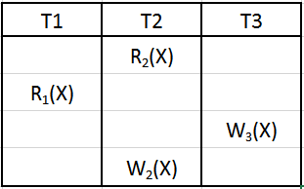
What is Blind Write?
blind write is simply when a transaction writes without reading. i.e a transaction have WRITE(Q), but no READ(Q) before it. So, the transaction is writing to the database "blindly" without reading previous value.
If there is no read that happens prior to the first write then it is said to be a blind write.
W3(X) is a blind write, as there is no read before write [R3(X) before W3(X)]
W2(X) is not a blind write, as a read happens before write [R2(X) before W2(X)]

Slide 44
Checking Whether a Schedule is View Serializable Or Not- Method-03: In this method, try finding a view equivalent serial schedule. By using the above three conditions, write all the dependencies. Then, draw a graph using those dependencies. If there exists no cycle in the graph, then the schedule is view serializable otherwise not.

Slide 45
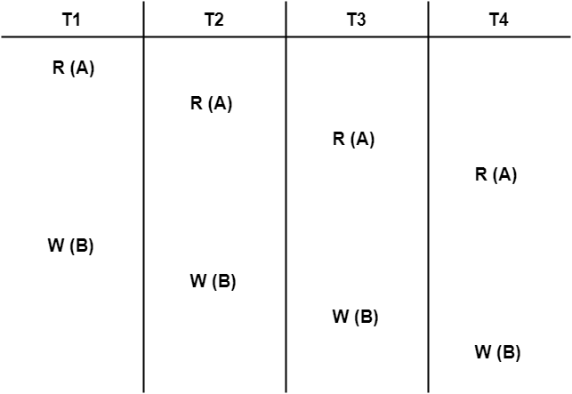
PRACTICE PROBLEMS BASED ON VIEW SERIALIZABILITY-
Problem-01:
Check whether the given schedule S is view serializable or not-
Solution-
We know, if a schedule is conflict serializable, then it is surely view serializable.
So, let us check whether the given schedule is conflict serializable or not.

Slide 46
Checking Whether S is Conflict Serializable Or Not- Problem-01:
Step-01:
List all the conflicting operations and determine the dependency between the transactions-
W₁(B) , W₂(B) (T₁ → T₂)
W₁(B) , W₃(B) (T₁ → T₃)
W₁(B) , W₄(B) (T₁ → T₄)
W₂(B) , W₃(B) (T₂ → T₃)
W₂(B) , W₄(B) (T₂ → T₄)
W₃(B) , W₄(B) (T₃ → T₄)

Slide 47
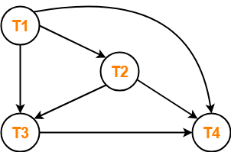
Problem-01:
Step-02:
Draw the precedence graph-
Clearly, there exists no cycle in the precedence graph.
Therefore, the given schedule S is conflict serializable.
Thus, we conclude that the given schedule is also view serializable.

Slide 48
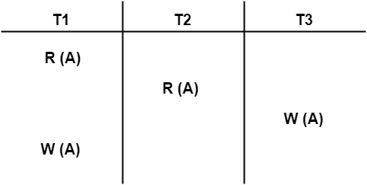
Problem-02:
Check whether the given schedule S is view serializable or not-
Solution-
We know, if a schedule is conflict serializable, then it is surely view serializable.
So, let us check whether the given schedule is conflict serializable or not.

Slide 49
Checking Whether S is Conflict Serializable Or Not-
Step-01:
List all the conflicting operations and determine the dependency between the transactions-
R₁(A) , W₃(A) (T₁ → T₃)
R₂(A) , W₃(A) (T₂ → T₃)
R₂(A) , W₁(A) (T₂ → T₁)
W₃(A) , W₁(A) (T₃ → T₁)

Slide 50
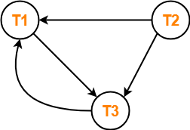
Checking Whether S is Conflict Serializable Or Not-
Step-02:
Draw the precedence graph-
Clearly, there exists a cycle in the precedence graph.
Therefore, the given schedule S is not conflict serializable.
Now,
Since, the given schedule S is not conflict serializable, so, it may or may not be view serializable.
To check whether S is view serializable or not, let us use another method.
Let us check for blind writes.

Slide 51
Checking for Blind Writes-
There exists a blind write W₃ (A) in the given schedule S.
Therefore, the given schedule S may or may not be view serializable.
Now,
To check whether S is view serializable or not, let us use another method.
Let us derive the dependencies and then draw a dependency graph.

Slide 52
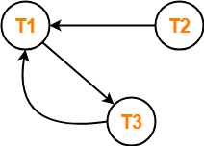
Checking for Blind Writes-
Drawing a Dependency Graph-
T1 firstly reads A and T3 firstly updates A.
So, T1 must execute before T3.
Thus, we get the dependency T1 → T3.
Final updation on A is made by the transaction T1.
So, T1 must execute after all other transactions.
Thus, we get the dependency (T2, T3) → T1.
There exists no write-read sequence.
Clearly, there exists a cycle in the dependency graph.
Thus, we conclude that the given schedule S is not view serializable.

Slide 53
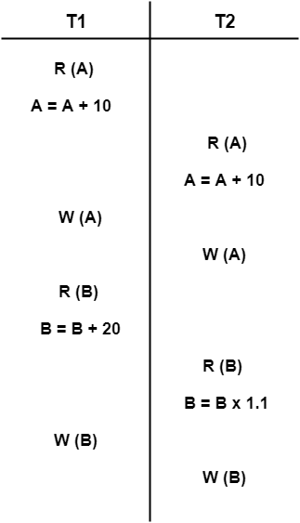
Problem-03:
Check whether the given schedule S is view serializable or not-

Slide 54
Solution-
We know, if a schedule is conflict serializable, then it is surely view serializable.
So, let us check whether the given schedule is conflict serializable or not.

Slide 55
Checking Whether S is Conflict Serializable Or Not-
Step-01:
List all the conflicting operations and determine the dependency between the transactions-
R₁(A) , W₂(A) (T₁ → T₂)
R₂(A) , W₁(A) (T₂ → T₁)
W₁(A) , W₂(A) (T₁ → T₂)
R₁(B) , W₂(B) (T₁ → T₂)
R₂(B) , W₁(B) (T₂ → T₁)

Slide 56
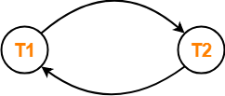
Step-02:
Draw the precedence graph-
Clearly, there exists a cycle in the precedence graph.
Therefore, the given schedule S is not conflict serializable.
Now,
Since, the given schedule S is not conflict serializable, so, it may or may not be view serializable.
To check whether S is view serializable or not, let us use another method.
Let us check for blind writes.

Slide 57
Checking for Blind Writes-
There exists no blind write in the given schedule S.
Therefore, it is surely not view serializable.
Alternatively,
You could directly declare that the given schedule S is not view serializable.
This is because there exists no blind write in the schedule.
You need not check for conflict serializability.

Slide 58
Problem-04:
Check whether the given schedule S is view serializable or not. If yes, then give the serial schedule.
S : R₁(A) , W₂(A) , R₃(A) , W₁(A) , W₃(A)

Slide 59
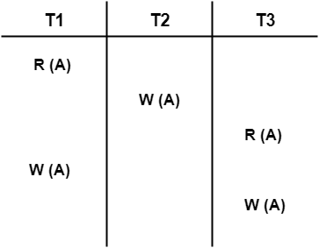
Solution-
For simplicity and better understanding, we can represent the given schedule pictorially as-
We know, if a schedule is conflict serializable, then it is surely view serializable.
So, let us check whether the given schedule is conflict serializable or not.

Slide 60
Checking Whether S is Conflict Serializable Or Not-
Step-01:
List all the conflicting operations and determine the dependency between the transactions-
R₁(A) , W₂(A) (T₁ → T₂)
R₁(A) , W₃(A) (T₁ → T₃)
W₂(A) , R₃(A) (T₂ → T₃)
W₂(A) , W₁(A) (T₂ → T₁)
W₂(A) , W₃(A) (T₂ → T₃)
R₃(A) , W₁(A) (T₃ → T₁)
W₁(A) , W₃(A) (T₁ → T₃)

Slide 61
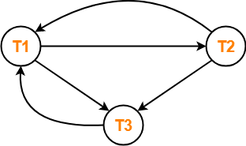
Step-02:
Draw the precedence graph-
Clearly, there exists a cycle in the precedence graph.
Therefore, the given schedule S is not conflict serializable.
Now,
Since, the given schedule S is not conflict serializable, so, it may or may not be view serializable.
To check whether S is view serializable or not, let us use another method.
Let us check for blind writes.

Slide 62
Checking for Blind Writes-
There exists a blind write W₂ (A) in the given schedule S.
Therefore, the given schedule S may or may not be view serializable.
Now,
To check whether S is view serializable or not, let us use another method.
Let us derive the dependencies and then draw a dependency graph.

Slide 63
Drawing a Dependency Graph-
T1 firstly reads A and T2 firstly updates A.
So, T1 must execute before T2.
Thus, we get the dependency T1 → T2.
Final updation on A is made by the transaction T3.
So, T3 must execute after all other transactions.
Thus, we get the dependency (T1, T2) → T3.
From write-read sequence, we get the dependency T2 → T3

Slide 64
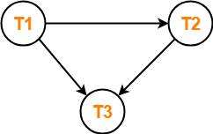
Now, let us draw a dependency graph using these dependencies-
Clearly, there exists no cycle in the dependency graph.
Therefore, the given schedule S is view serializable.
The serialization order T1 → T2 → T3.

Slide 65
Next: Non-Serializable Schedules
Next Topic

Slide 66


